Slide 1







Statistical Analysis of SpaceX Rocket Launch Data
Kevin Ruth
June 2, 2023

Slide 2



OUTLINE
Executive Summary
Introduction
Methodology
Results
Visualization – Charts
Dashboard
Discussion
Findings & Implications
Conclusion
Appendix

Slide 3

EXECUTIVE SUMMARY
Date gathered from
SpaceX website with API
Wikipedia by webscraping methods
Data cleaning and wrangling to prepare for analysis
Date Visualizations
Pie Charts, Bar Charts, Scatterplots
Geospatial visualizations (maps)
Dashboard displaying Pie chart, scatterplot, payload slider
Models to predict Mission Success
Logistic Regression
Support Vector Machine
Decision Tree
K Nearest Neighbors

Slide 4

INTRODUCTION
We wish to estimate probability of mission success, for the objective of estimating cost to a potential competitor in the rocket launch business.

Slide 5

METHODOLOGY – Data Collection
Data Collection was based on two main methods and done using python and jupyter notebooks.
SpaceX API at the SpaceX Data Website
Webscraping at Wikipedia page

Slide 6
METHODOLOGY – Data Wrangling
Using jupyter notebooks with python, Data had to be cleaned initially before we could do the analysis with visualizations and model development.
Empty data items were either deleted or replaced with a mean for that feature.
Dummy variables were used for categorical variables.

Slide 7
METHODOLOGY – EDA
Using jupyter notebooks, python and SQL, we explored various statistical measures for the SpaceX data.
This included exploring total payloads carried by various boosters, total number of successful and unsuccessful landing outcomes, and finding boosters which succeeded landing on drone ship.

Slide 8
METHODOLOGY – Visual Analytics
Using jupyter notebooks and python, and using the matploblib and seaborn libraries, we produced several scatterplots, bar graphs and line charts.
We explored relationships between payload and flight number, launch site and glight number, launch site vs payload, and orbit type vs success rate.

Slide 9
METHODOLOGY – Predictive Analysis
Using jupyter notebooks and python, and using the sk-learn library, we developed, trained and tested various types of predictive models.
We developed models of the following types:
Logistic Regression
Support Vector Machine
Decision Trees
K Nearest Neighbors

Slide 10
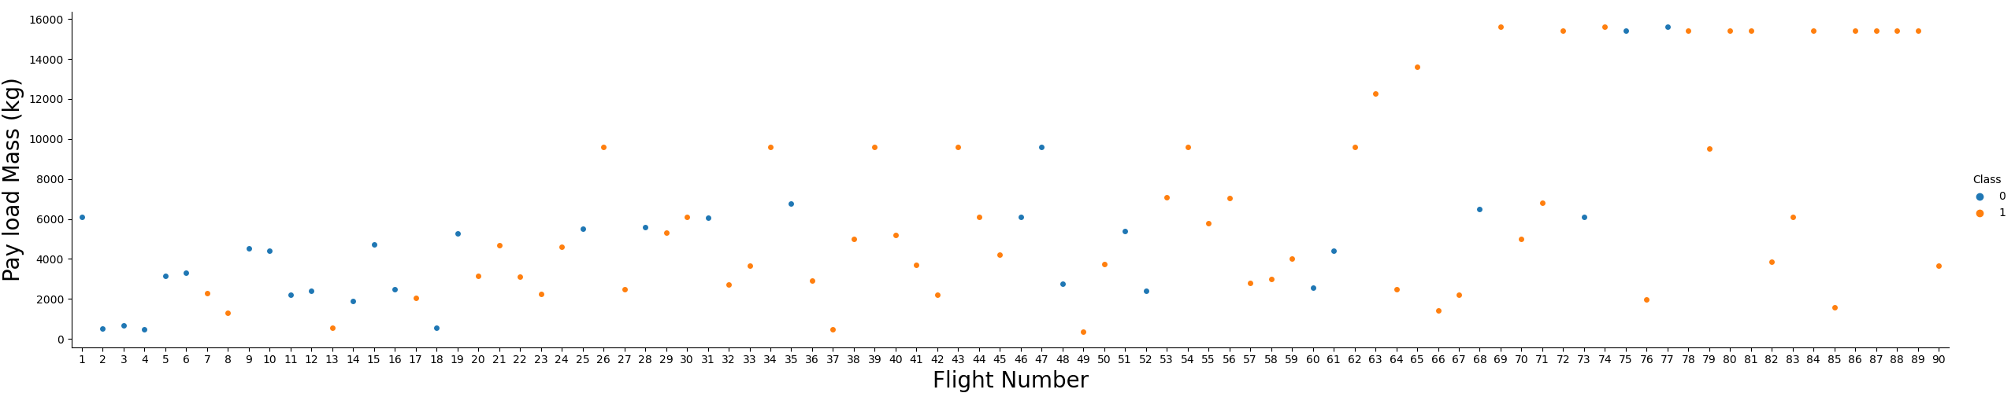
Payload Mass vs. Flight Number

Slide 11
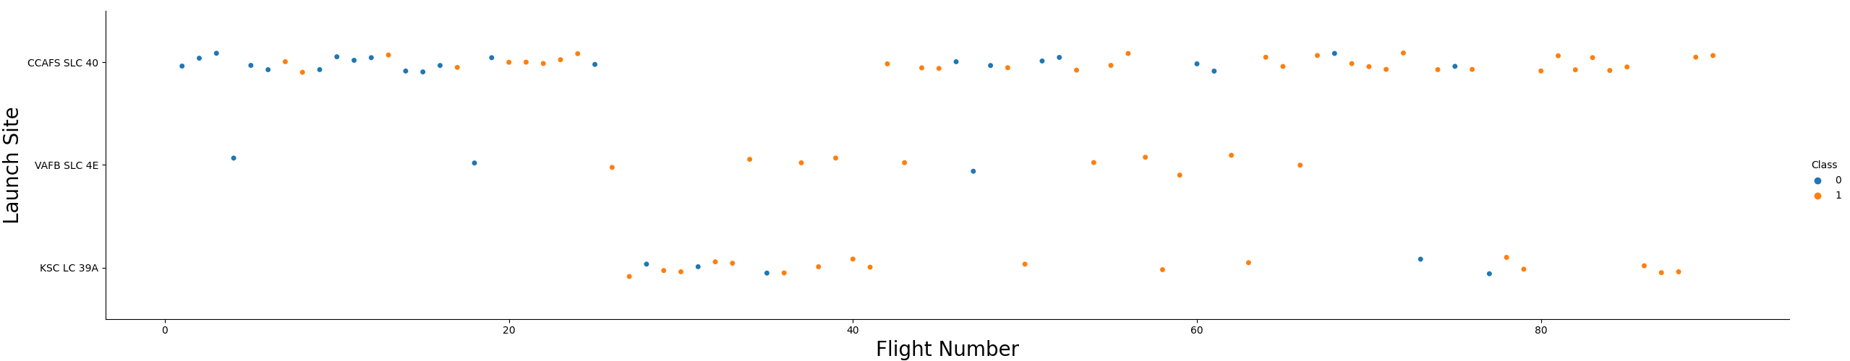
Launch Site vs. Flight Number

Slide 12
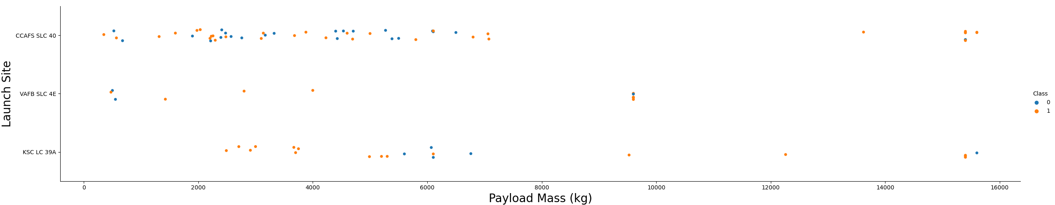
Launch Site vs. Payload

Slide 13
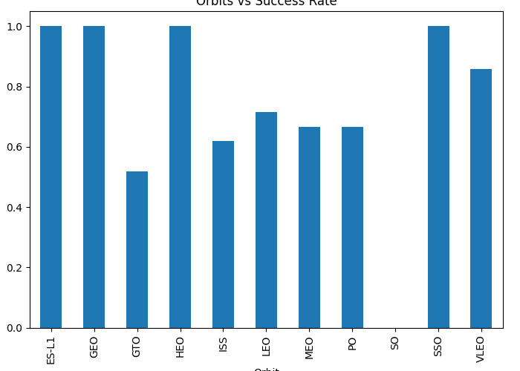
Orbits vs. Success Rate

Slide 14
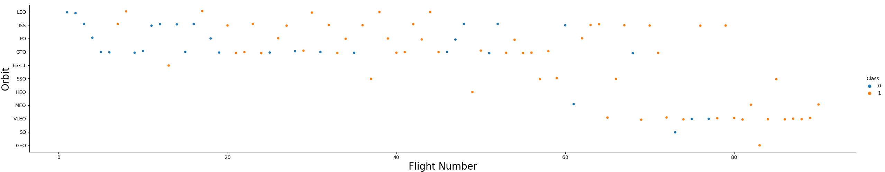
Orbits vs. Flight Number

Slide 15
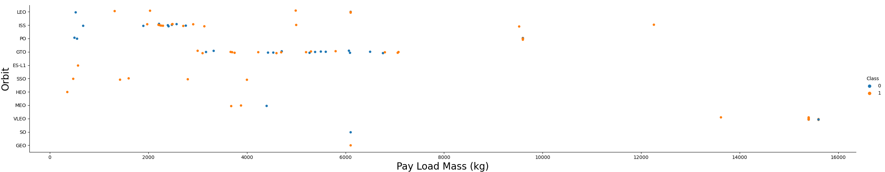
Orbit Type vs Payload

Slide 16
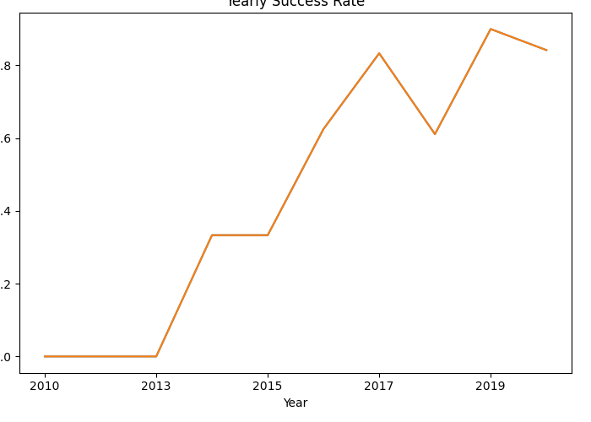
Yearly Success Rate

Slide 17
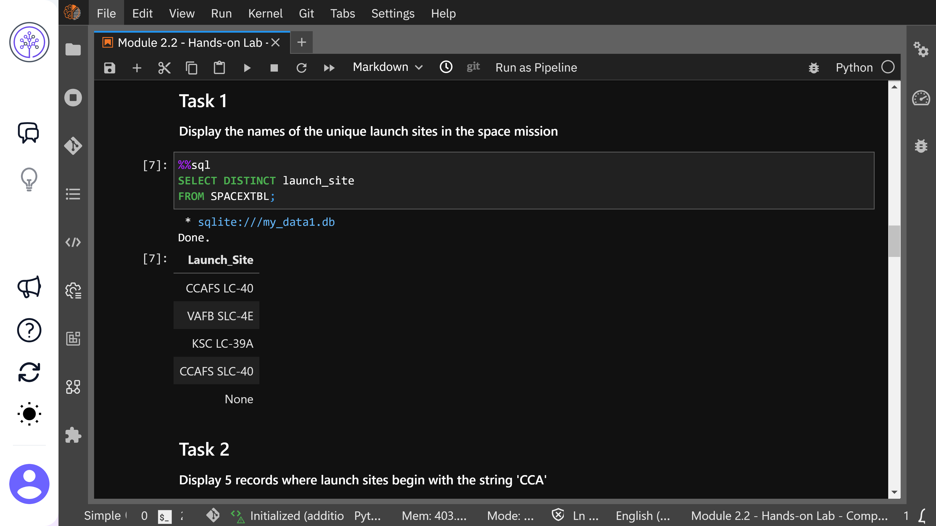
Distinct Launch Sites (SQL)

Slide 18
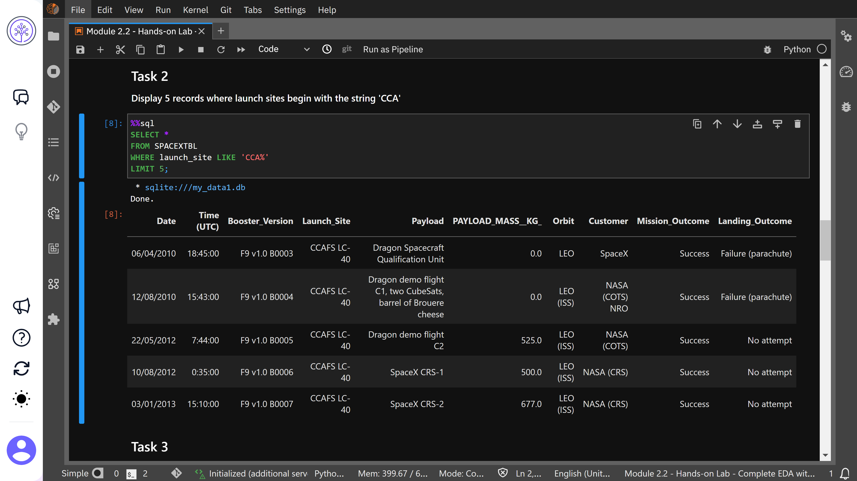
5 Records With Launch Sites Beginning With ‘CCA’

Slide 19
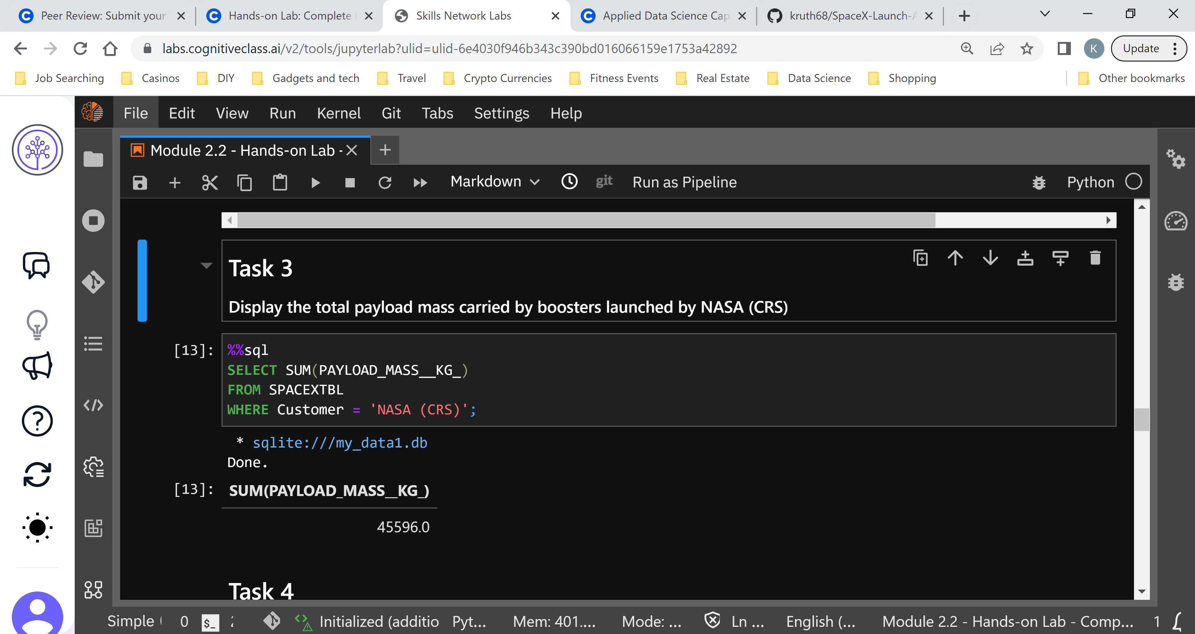
Total Payload Mass Carried by Boosters Launched by NASA (CRS)

Slide 20
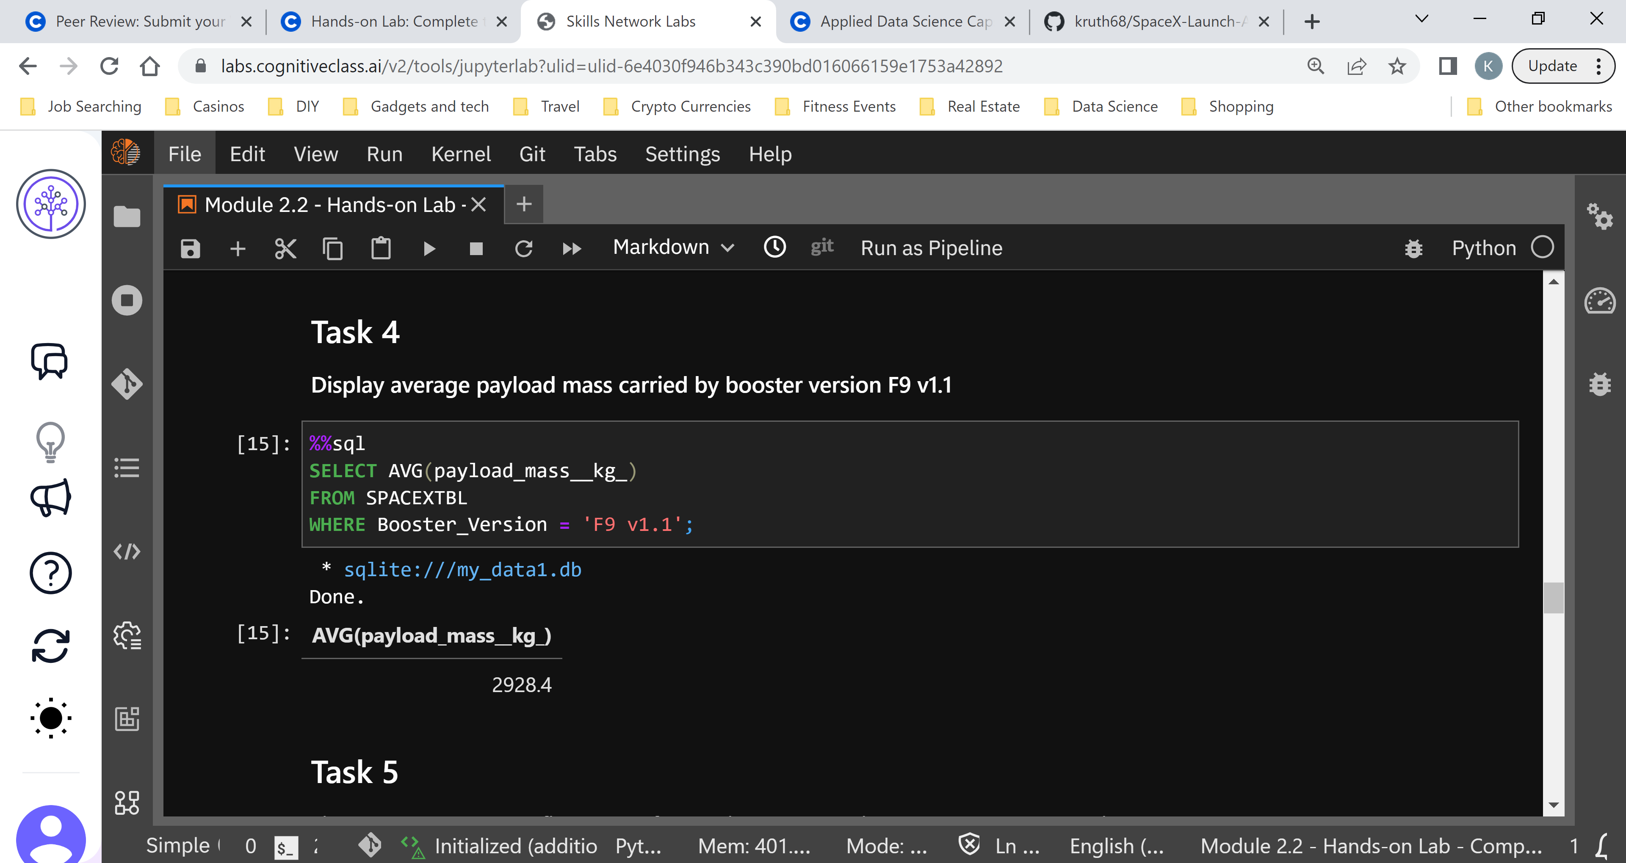
Average Payload Mass Carried by Boosters Version F9 v1.1

Slide 21
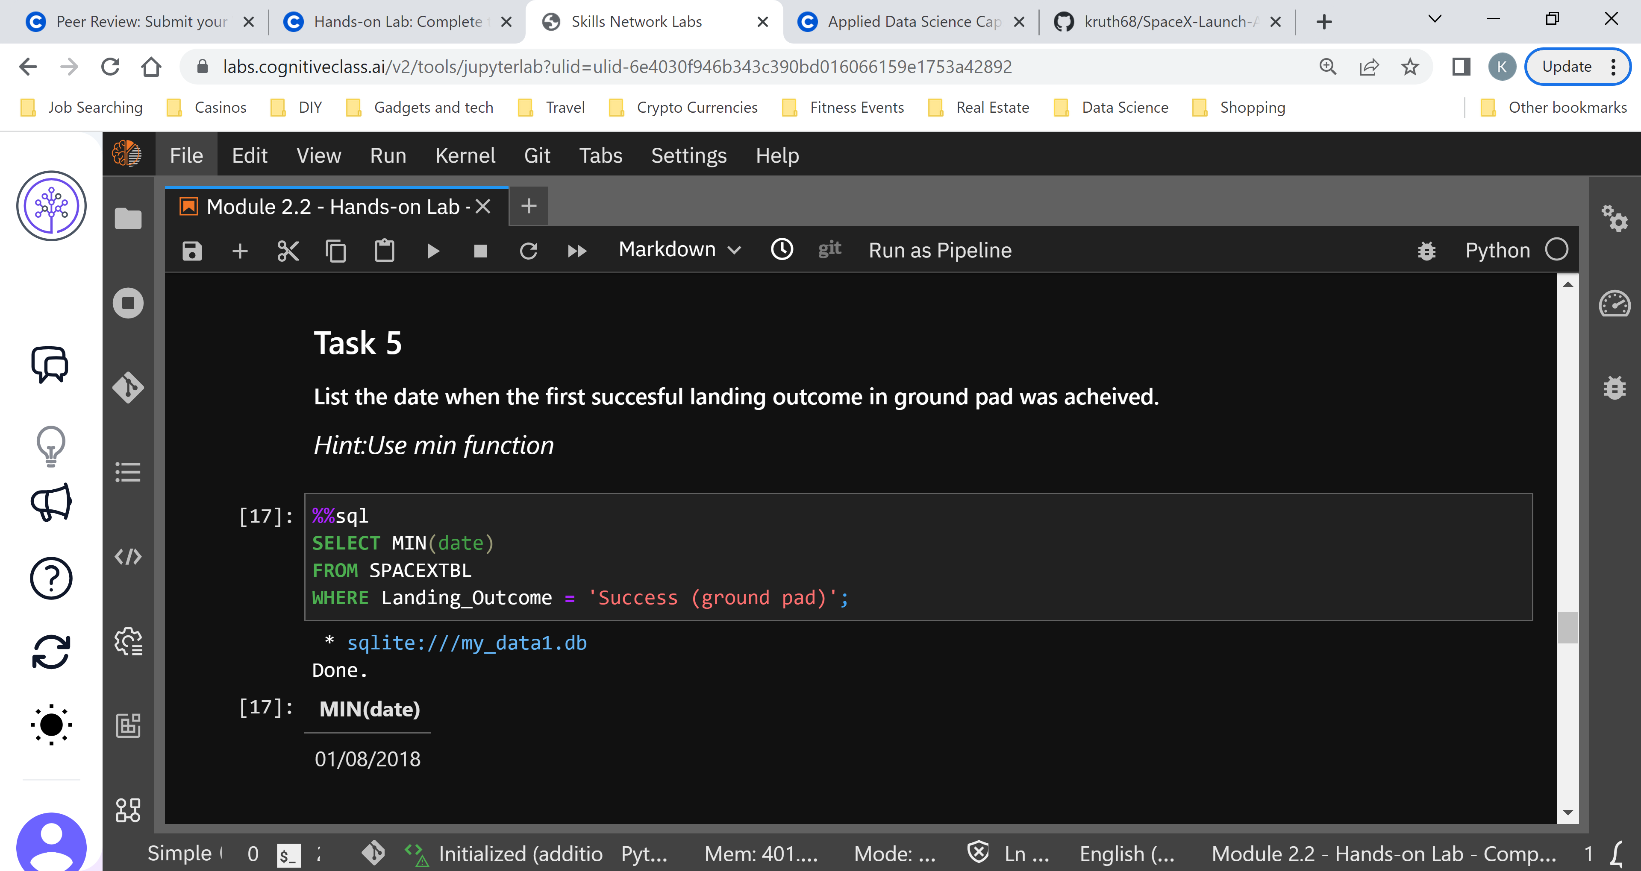
Date of First Successful Landing Outcome in Ground Pad

Slide 22
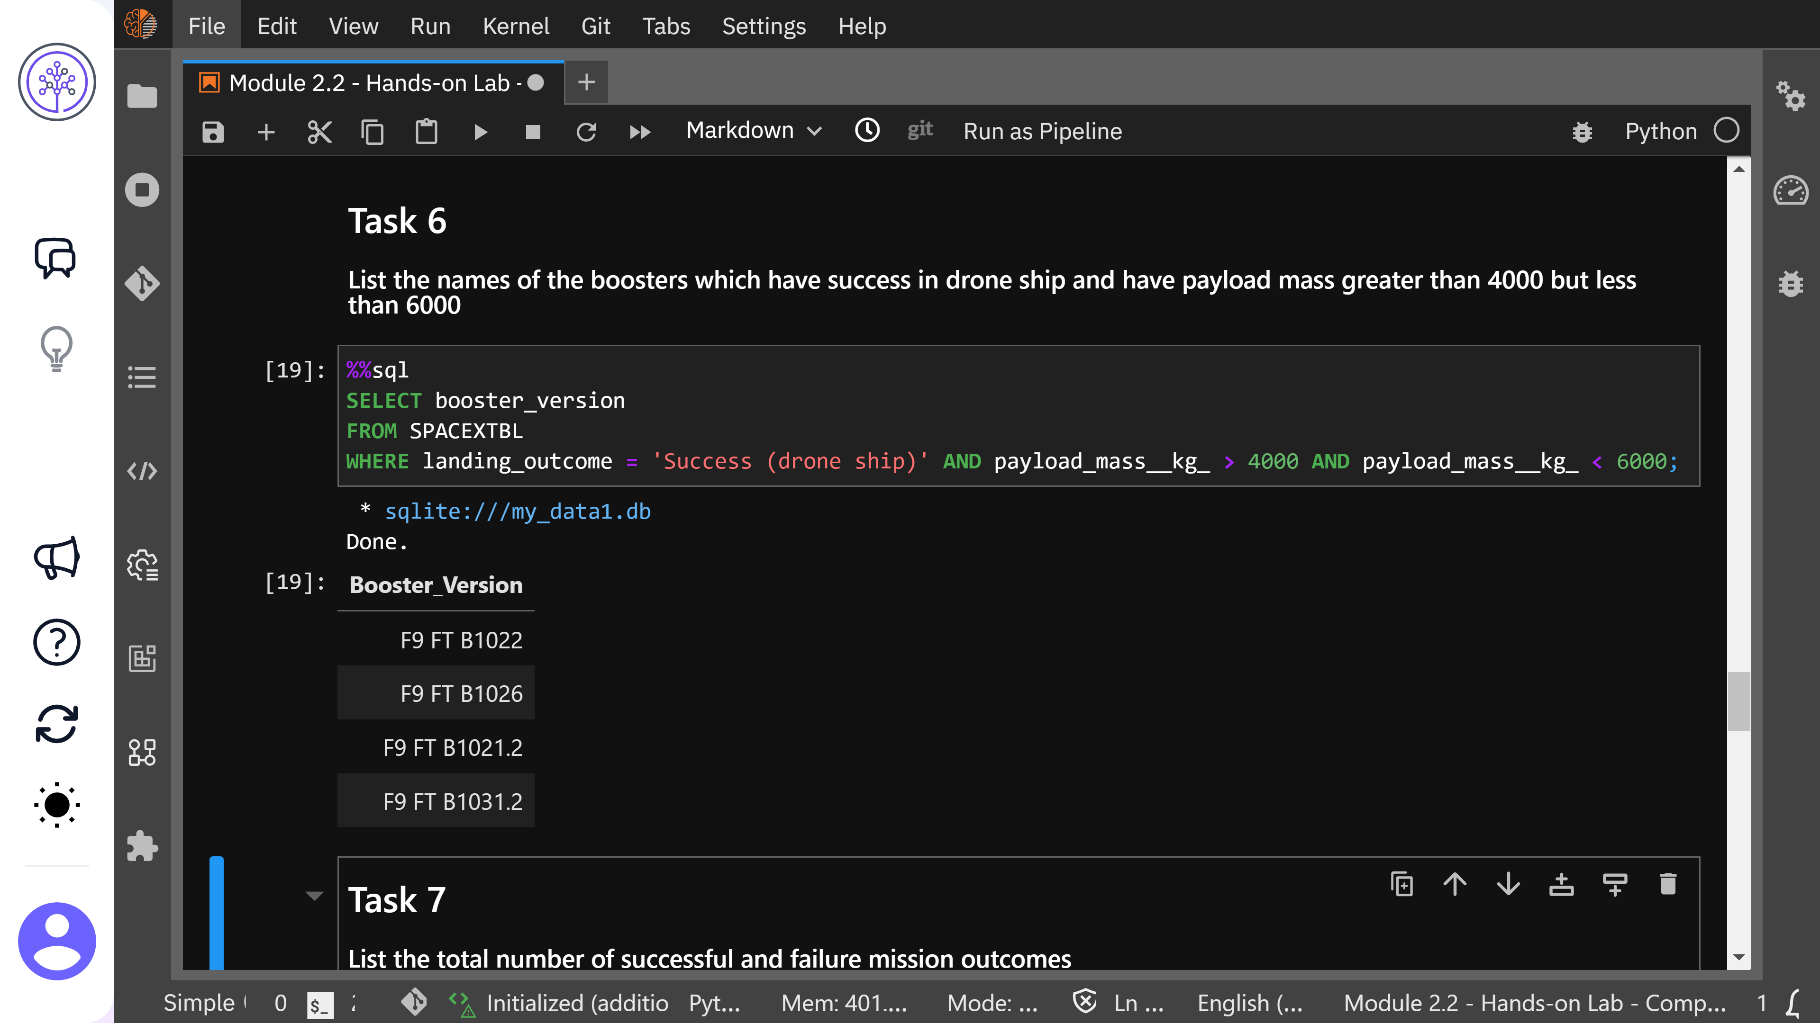
Boosters Which Succeeded Landing on Drone Ship with mass between 4000 and 6000

Slide 23
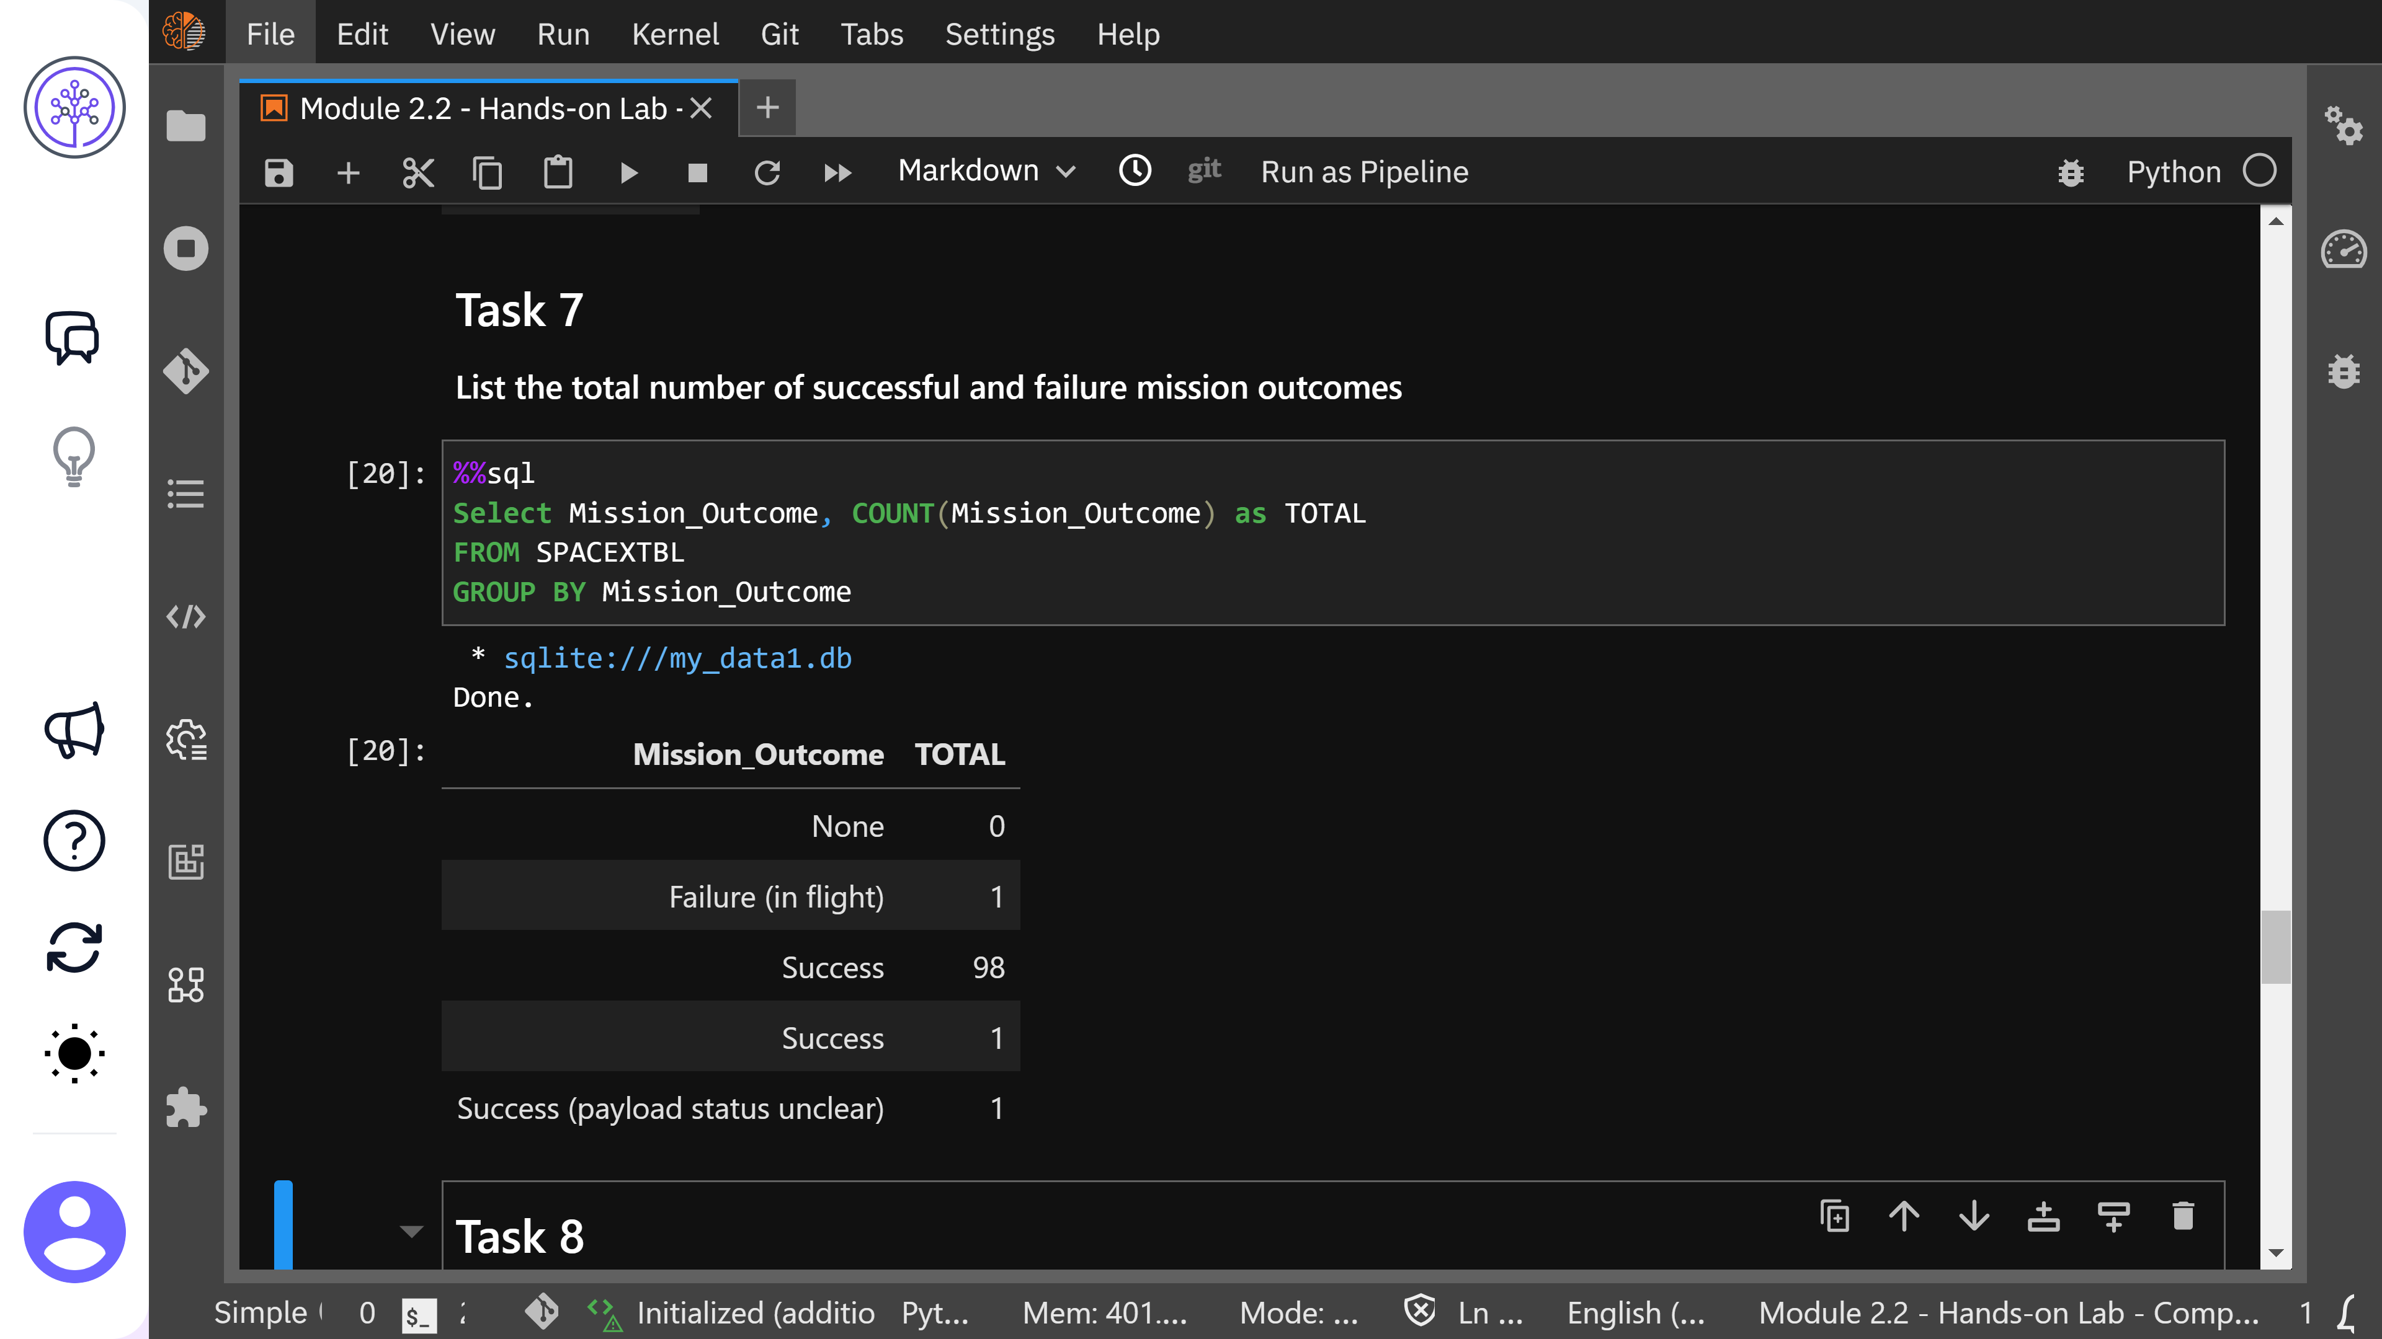
Total Number of Successful and Failure Mission Outcomes

Slide 24
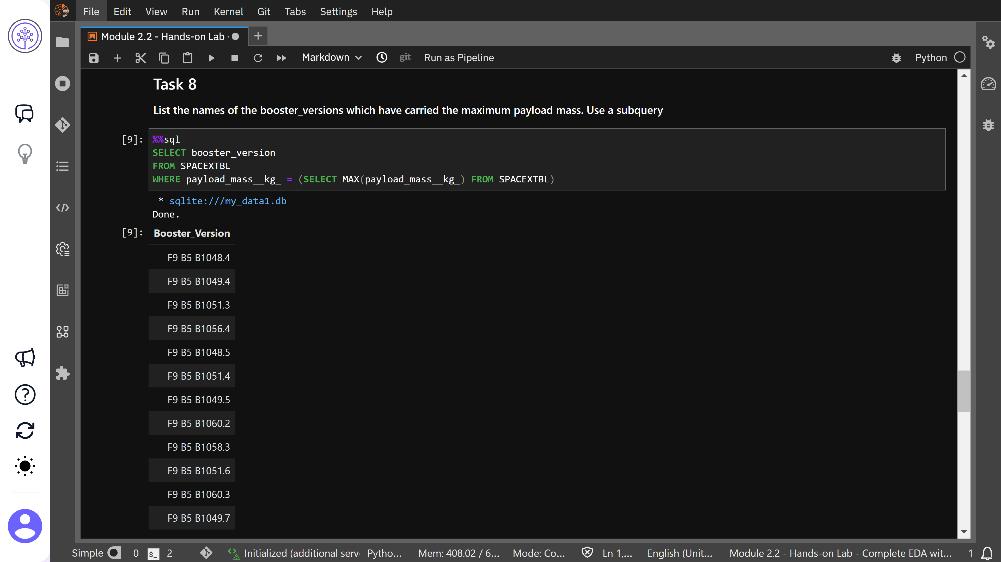
Boosters Which Have Carried the Maximum Payload Mass

Slide 25
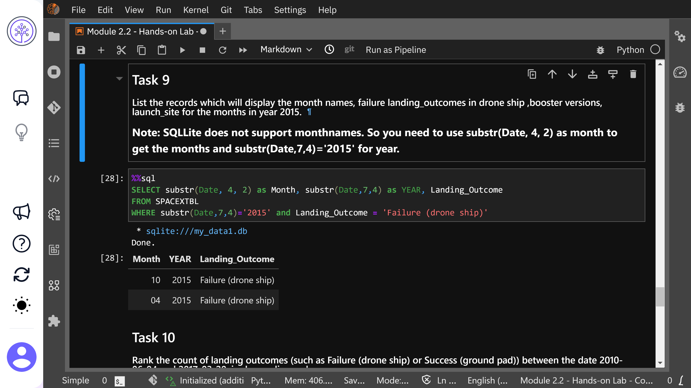
Failed Landings in 2015

Slide 26
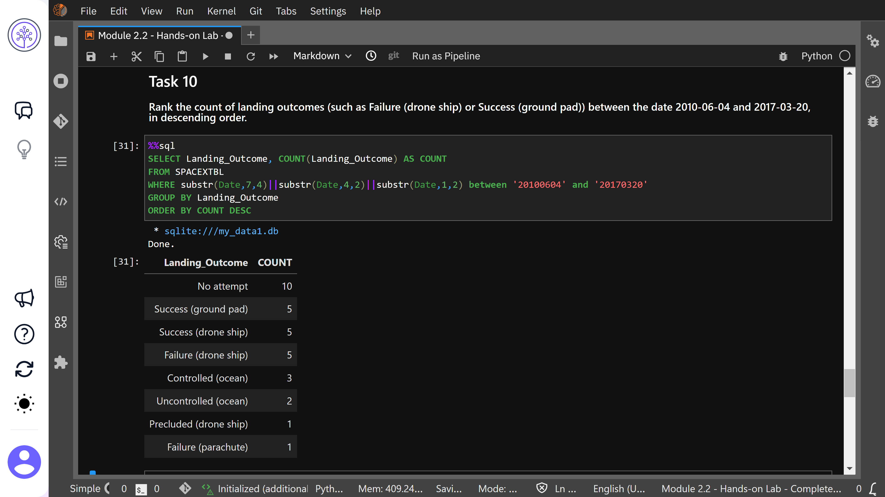
Most Common Outcomes Between 2010-06-04 and 2017-03-20

Slide 27
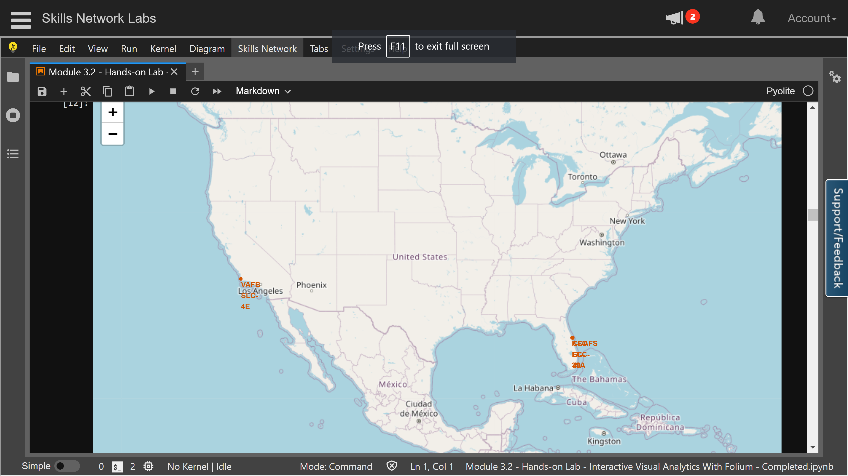
Launch Site Locations

Slide 28
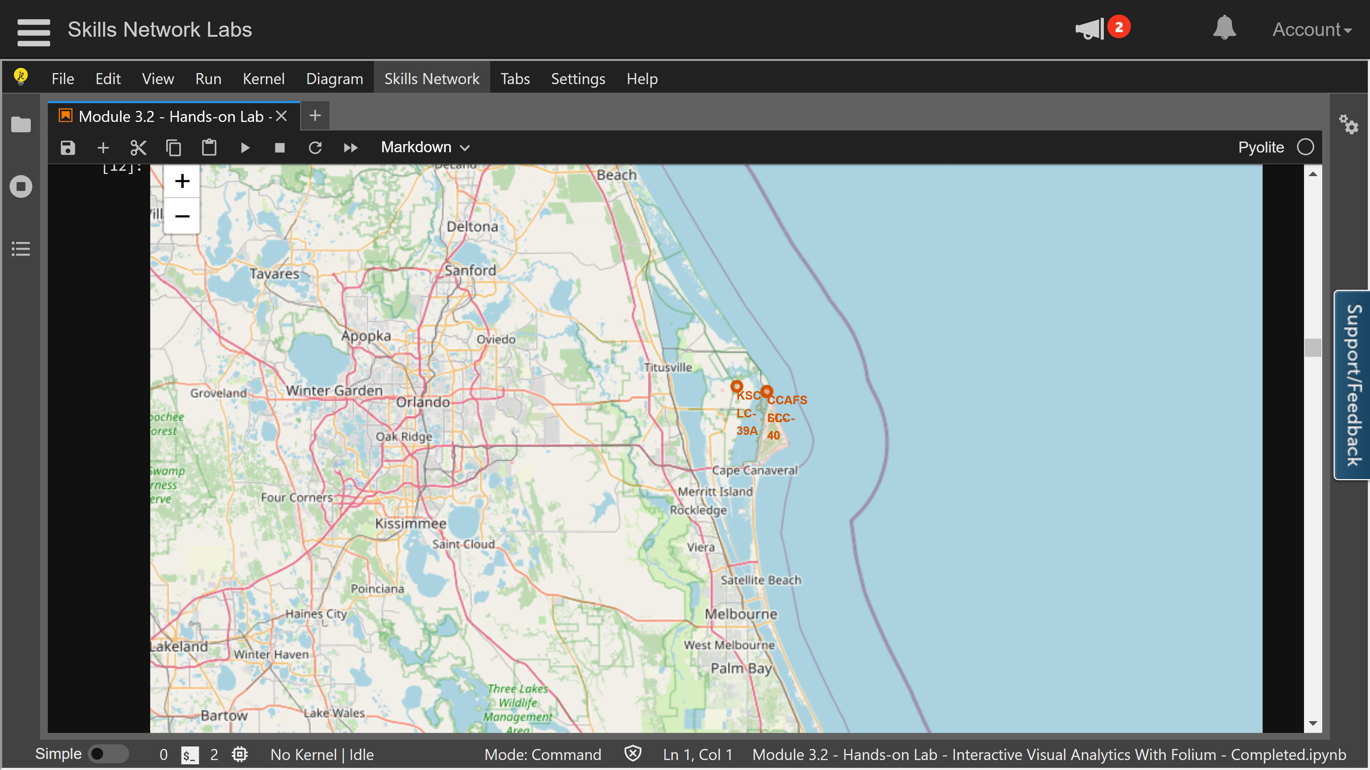
Launch Site Locations

Slide 29
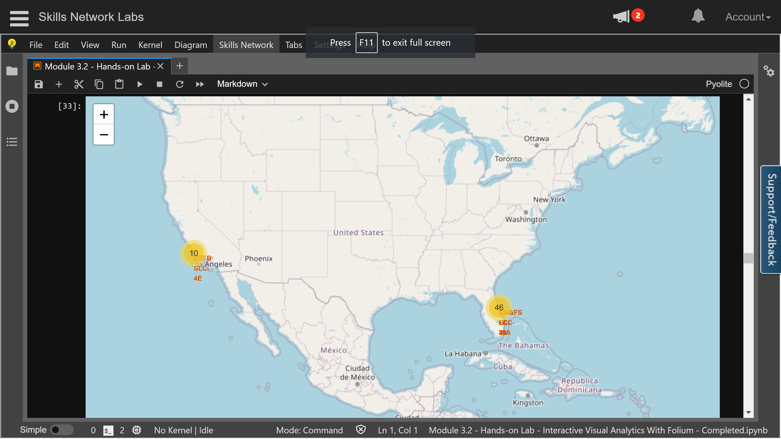
Locations for Successful and Unsuccessful Landings

Slide 30
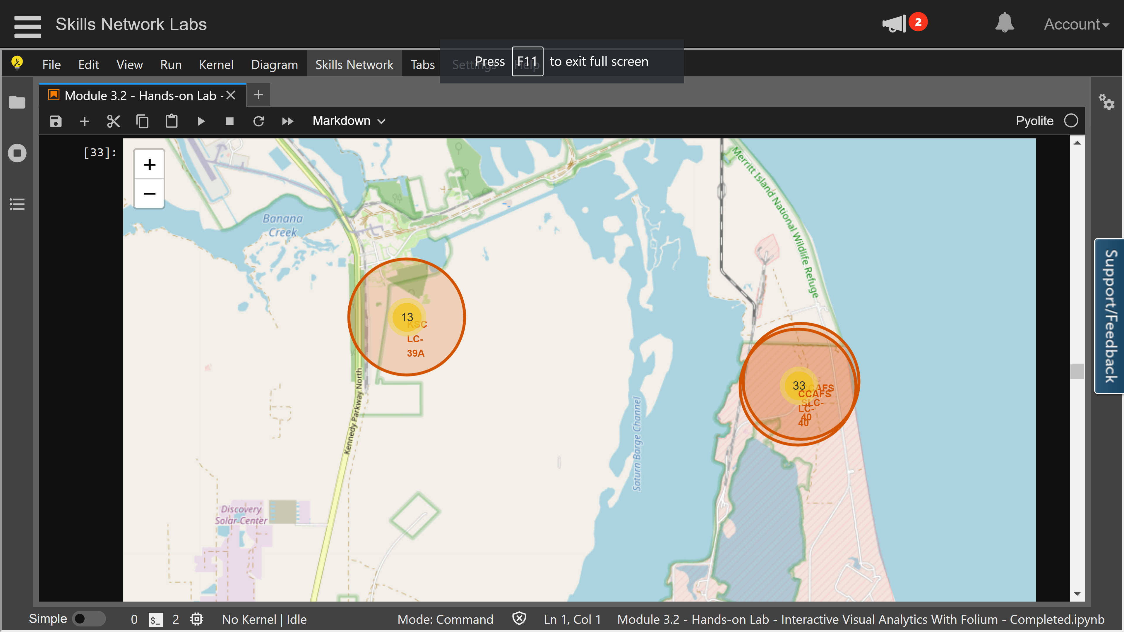
Locations for Successful and Unsuccessful Landings

Slide 31
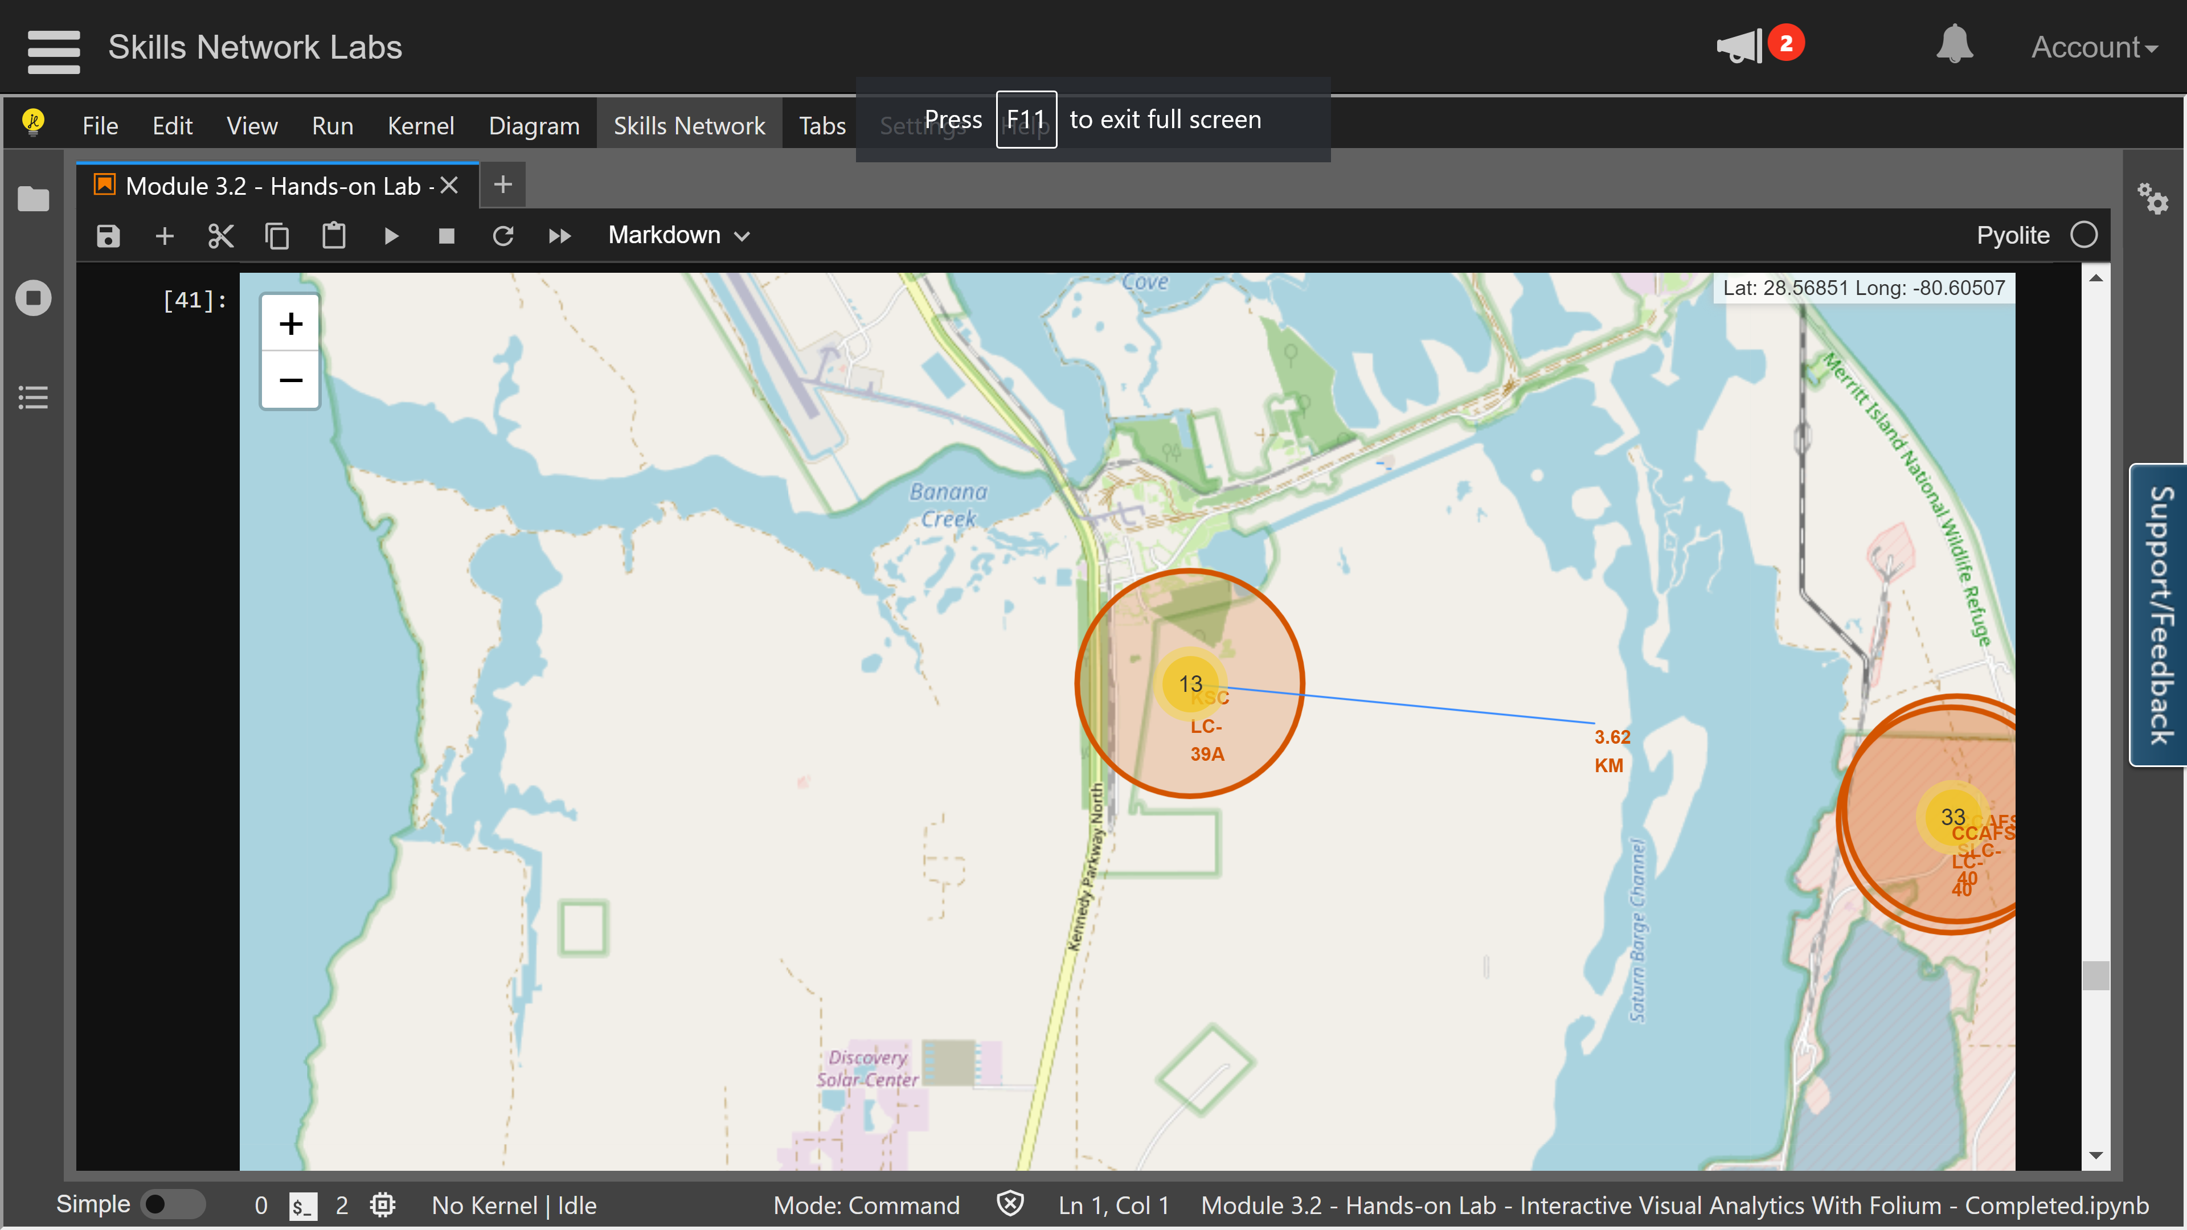
Launch Site Proximity - Coastline

Slide 32

DASHBOARD
The following slides show screen shots of the various dashboard features

Slide 33
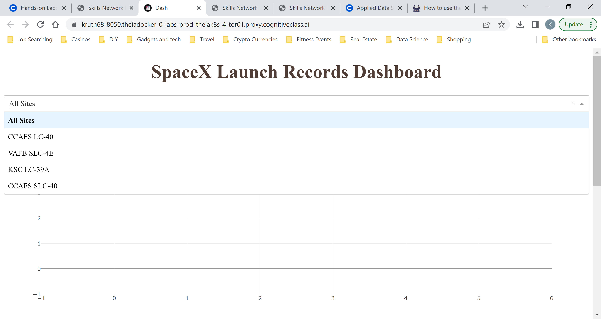
DASHBOARD TAB 1
Screenshot of dashboard tab 1 goes here
Notes:
Dropdown menu for User to select launch site for analysis

Slide 34
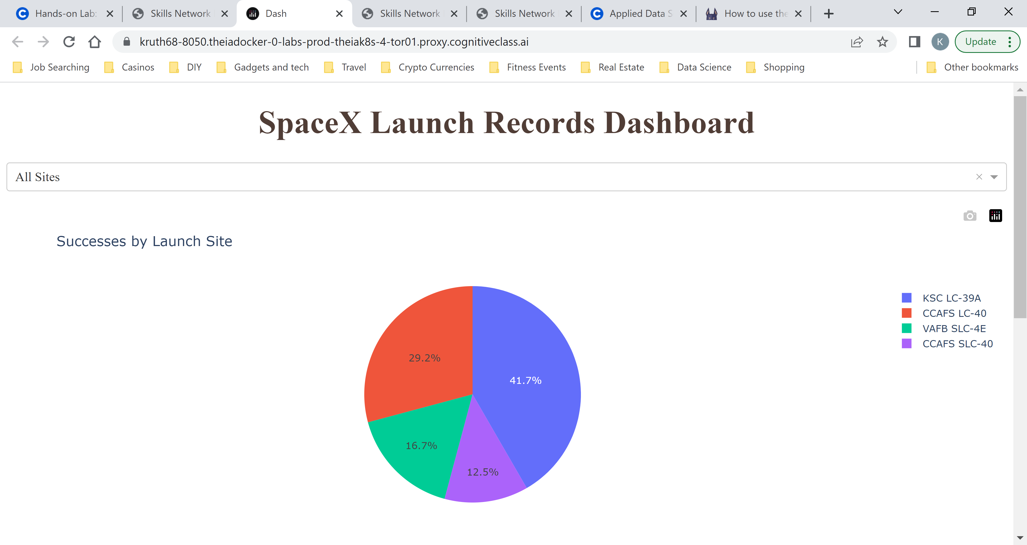
Pie Chart for All Launch Sites
Screenshot of dashboard tab 2 goes here
Notes:
Pie chart displaying success rates for launch sites

Slide 35
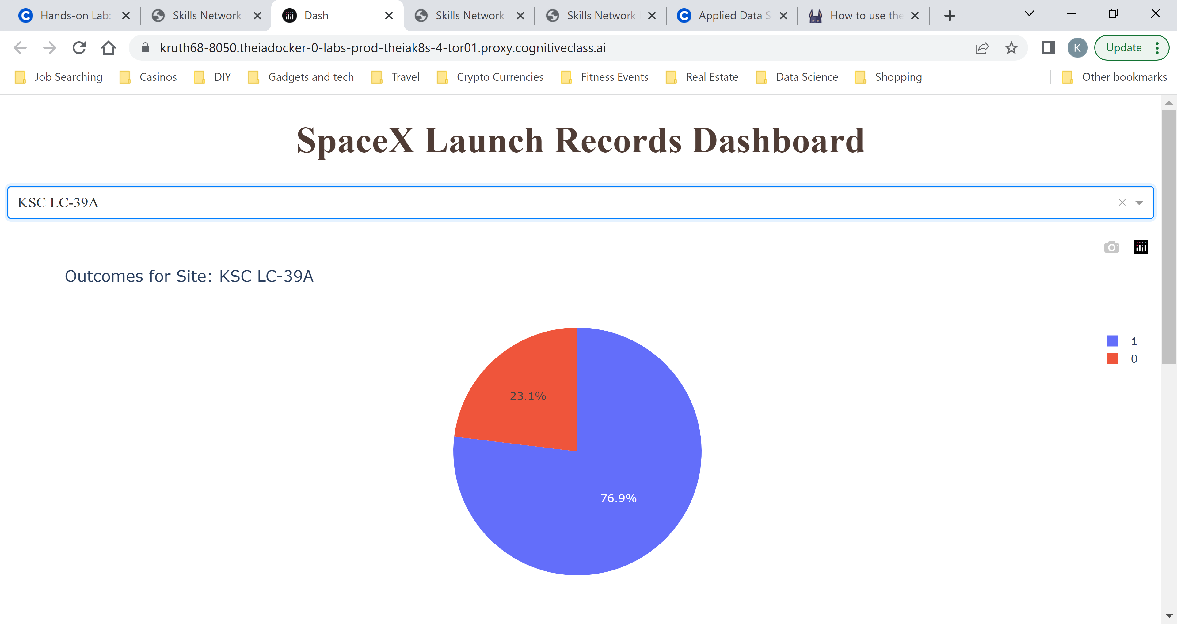
Pie Chart for Single Launch Site
Screenshot of dashboard tab 3 goes here
Notes:
Pie Chart displaying success rate for selected launch site

Slide 36
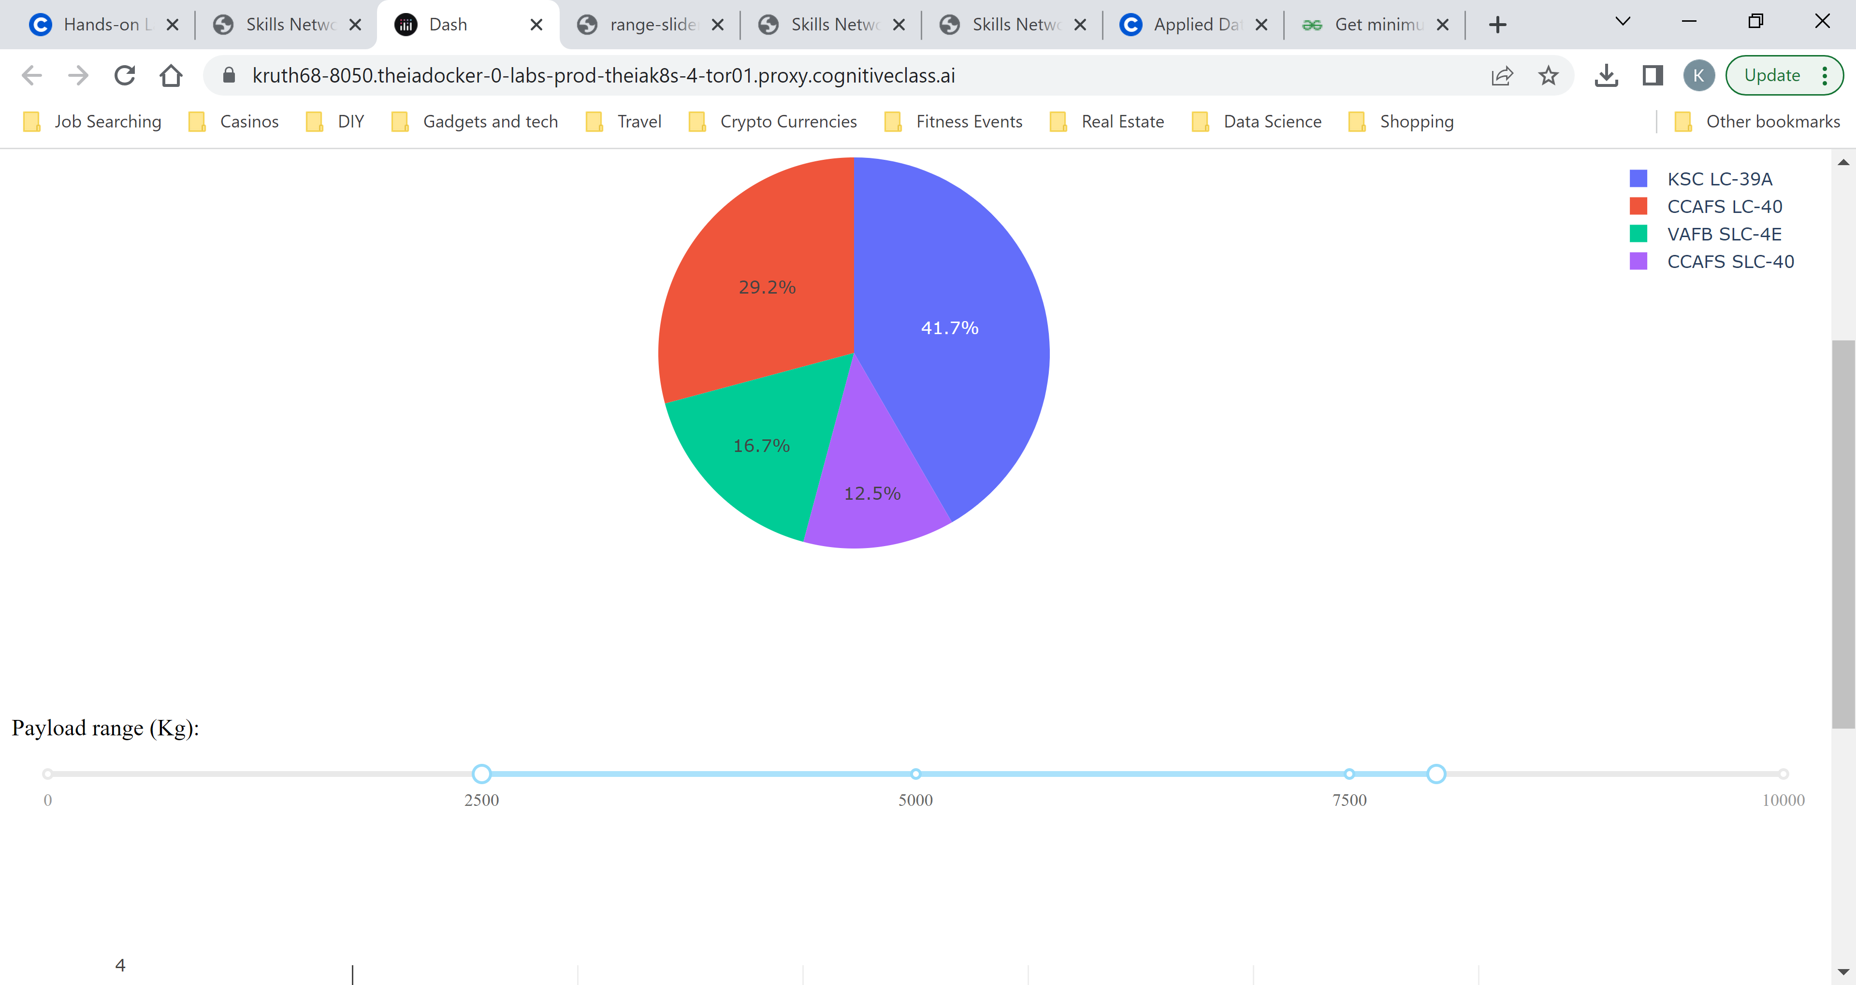
Slider for Payload Mass

Slide 37
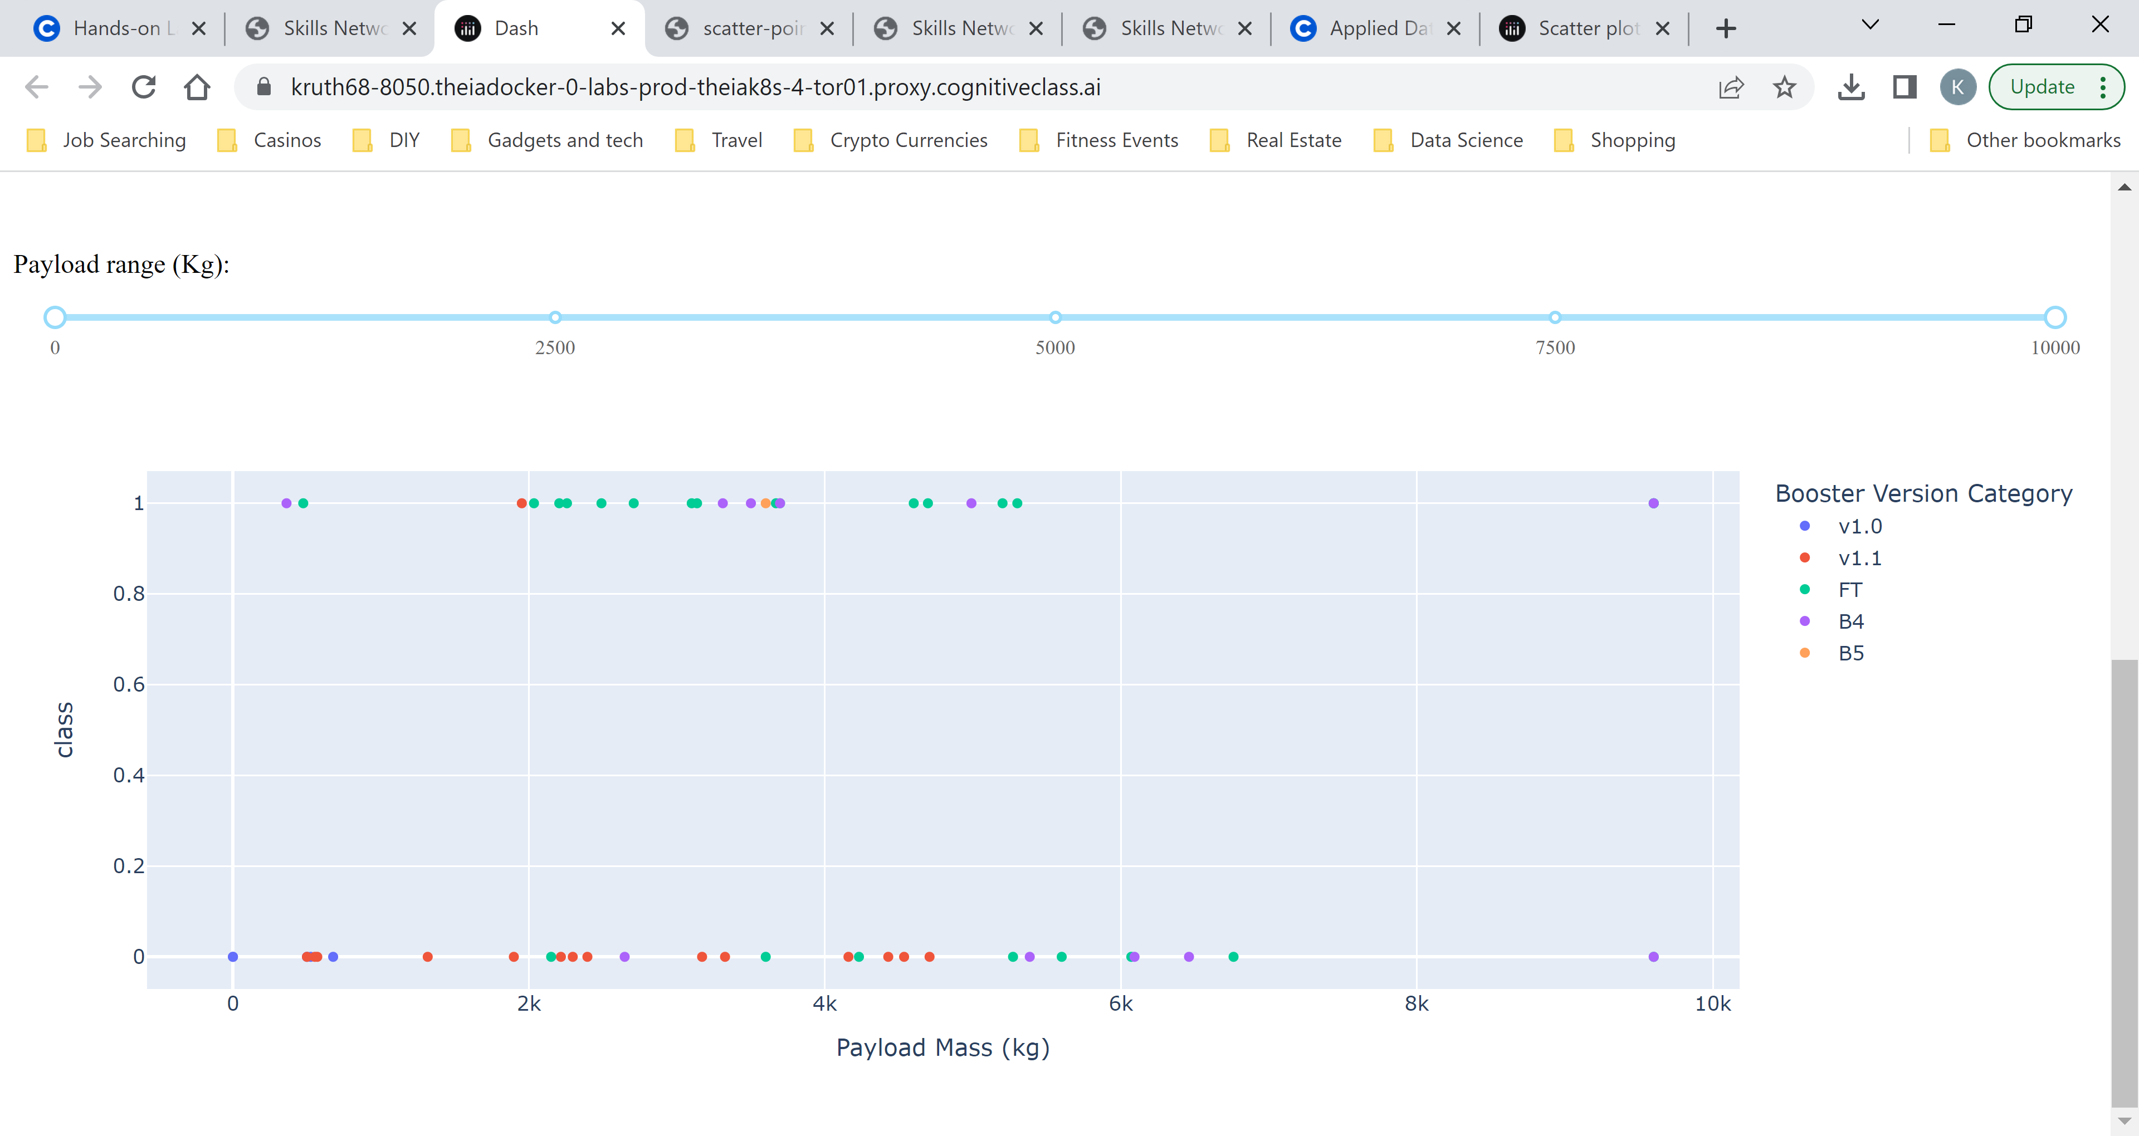
Scatter Chart Using Slider

Slide 38
Predictive Analysis Results – Logistic Model
Findings
The Best Logistic Model used the following parameters:
C = 0.01
Penalty equal 12
Lbfgs
Training data accuracy 0.846
Test data accuracy 0.833

Slide 39
Predictive Analysis Results – Support Vector Machine
Findings
The Best SVM Model used the following parameters:
C = 1.0
Kernel: sigmoid
Gamma: 0.032
Training data accuracy 0.848
Test data accuracy 0.833

Slide 40
Predictive Analysis Results – Decision tree
Findings
The Best Tree Model used the following parameters:
Cirterion: gini
Max depth: 14
Max features: sqrt
Training data accuracy 0.877
Test data accuracy 0.833

Slide 41
Predictive Analysis Results – K Neighbors
Findings
The Best knn Model used the following parameters:
Algorithm: auto
Neighbors: 10
P = 1
Training data accuracy 0.848
Test data accuracy 0.833

Slide 42
Predictive Analysis Results - Overall
Findings
Best Logistic Model used alpha 0.01 and a score of 0.83 on the test data
Best SVM model used the sigmoid kernel and a score of 0.83 on the test data
Best Tree model used the gini criterion and had score 0.83 on the test data
Best k Neighbors model used the auto algorithm with 10 neighbors and had score 0.83 on the test data
Implications
All 4 model types had the exact same score on the test data
All 4 models had the same confusion matrix
It appears that all 4 models are equally good
The accuracy of either of these models is approximately 0.83

Slide 43

CONCLUSION
Success Rates increased through the years
KSC had the highest success rate
Either of the models, including logistic, SVM, Decision tree or knn performed equally well
Prediction accuracy for these models is 0.83

Slide 44

APPENDIX
Include any relevant additional charts, or tables that you may have created during the analysis phase.

